Slide 1
Superstore sales datasheet:

Slide 2
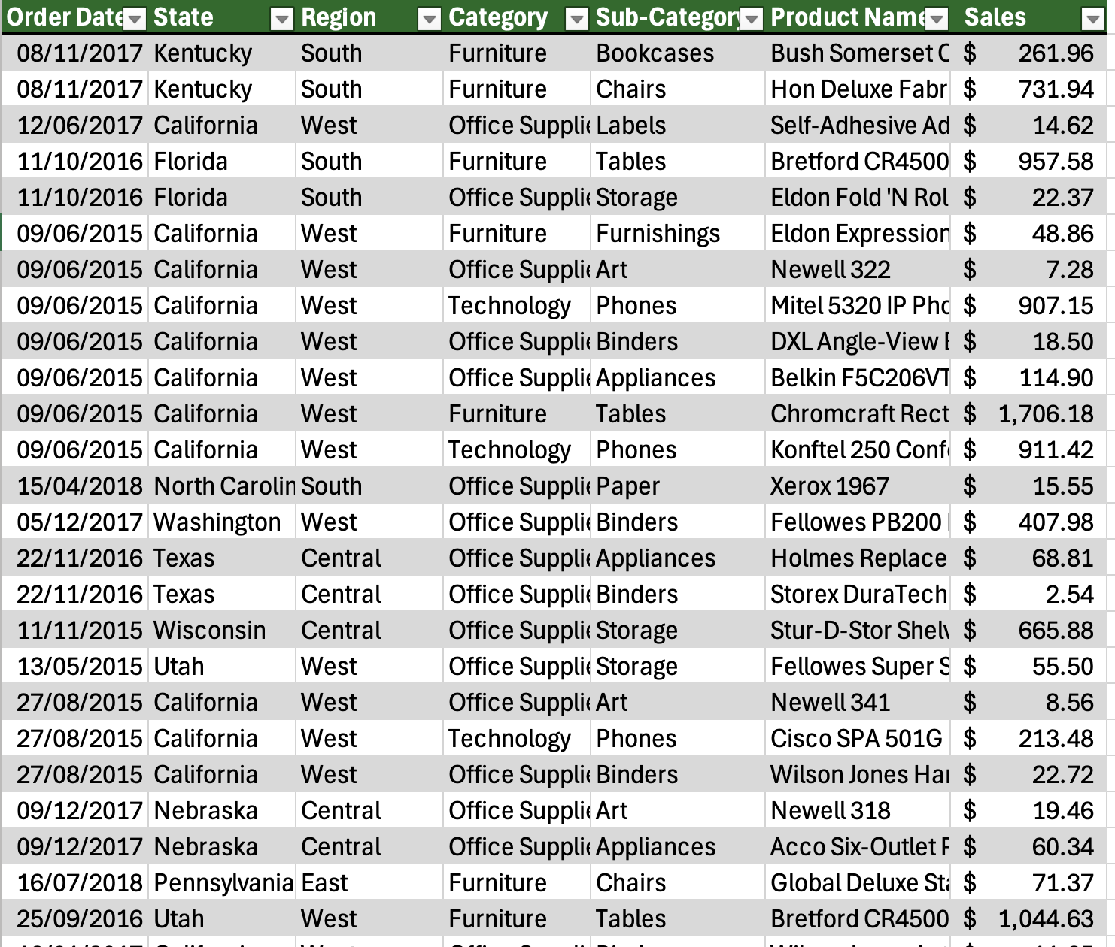

Slide 3
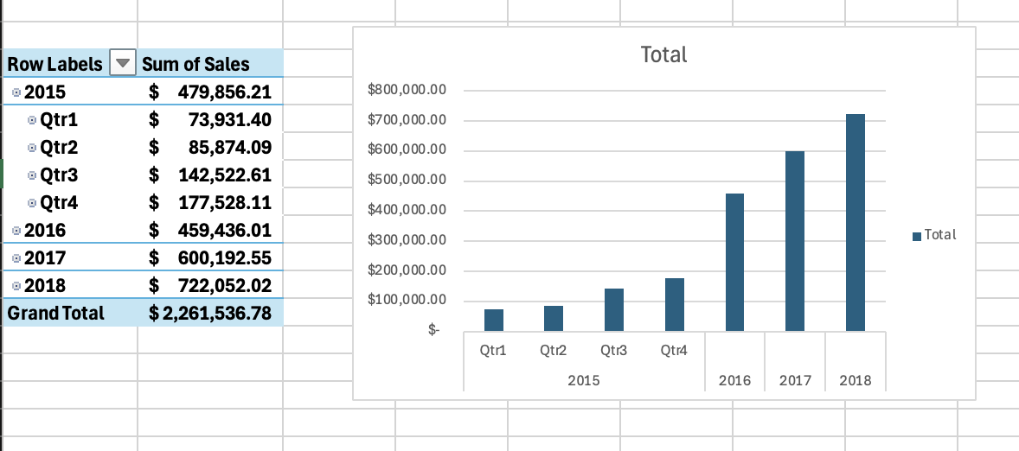
PivotTable for totals by month (monthly trend)

Slide 4
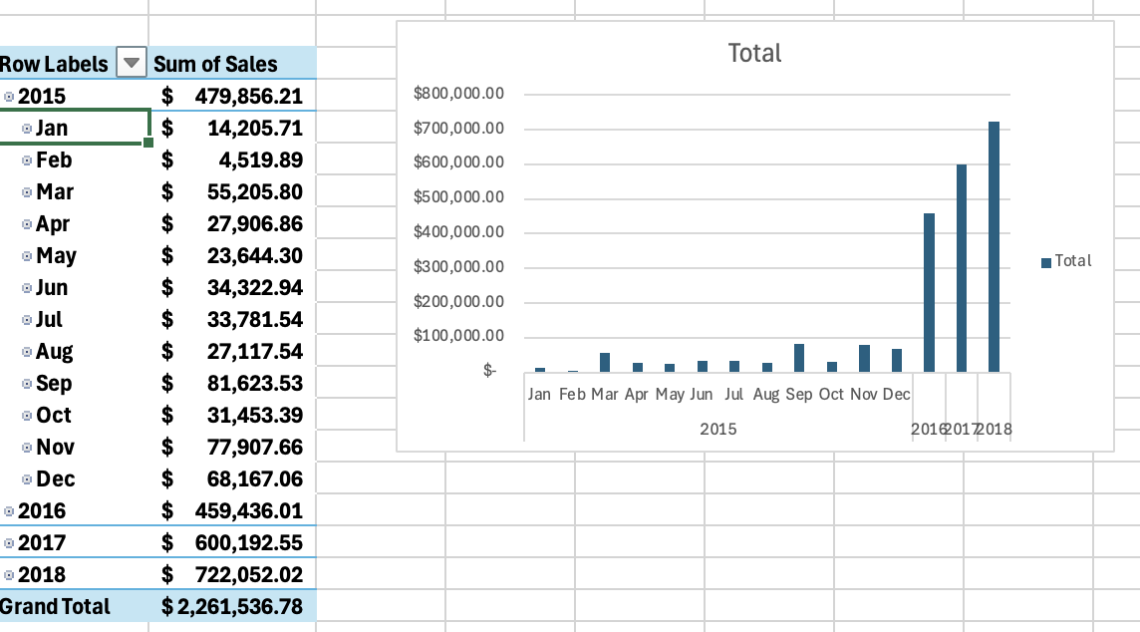

Slide 5
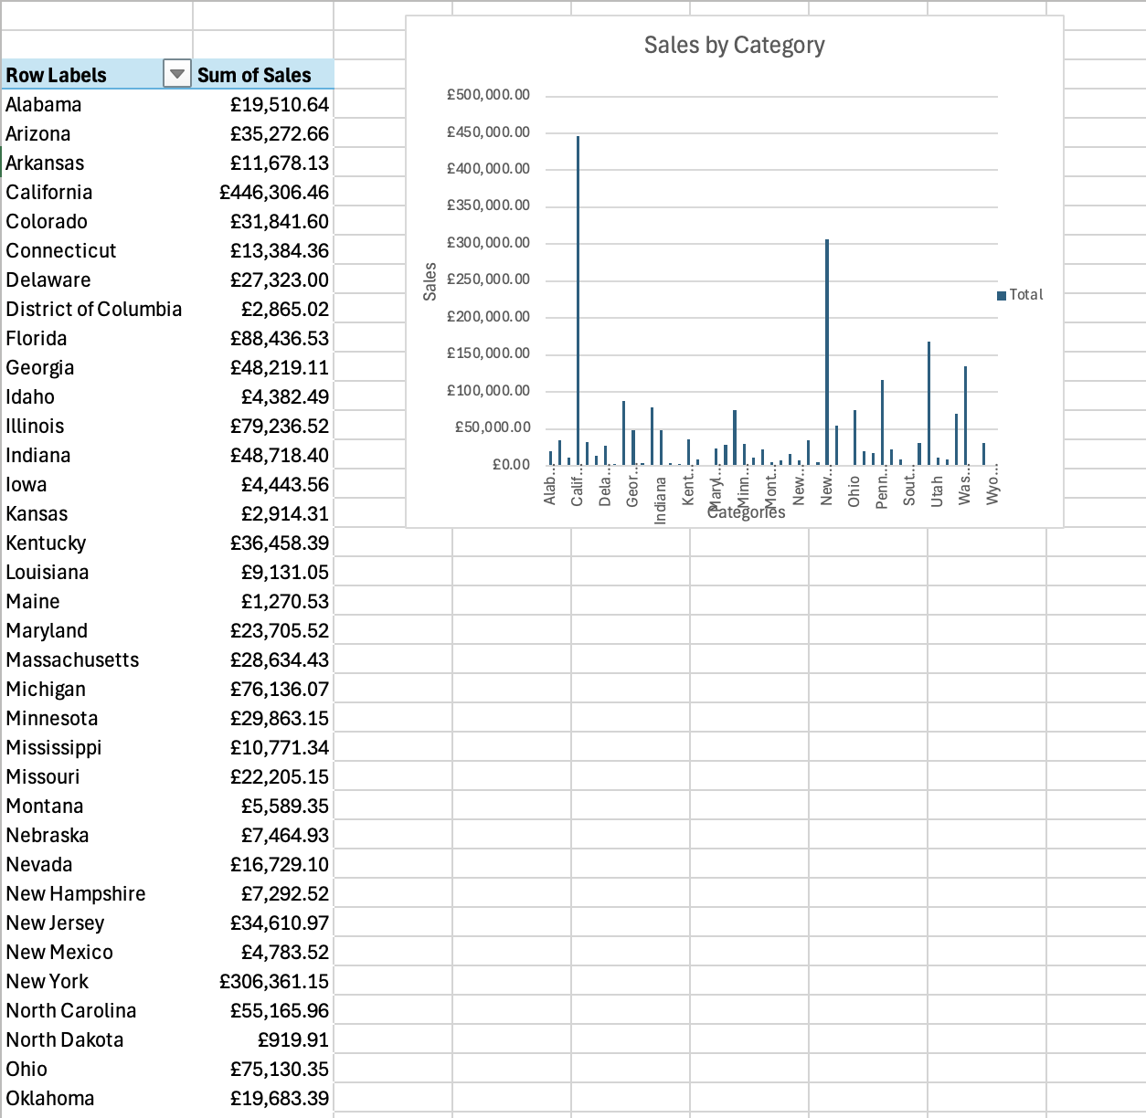
Pivot: Sales by Category

Slide 6
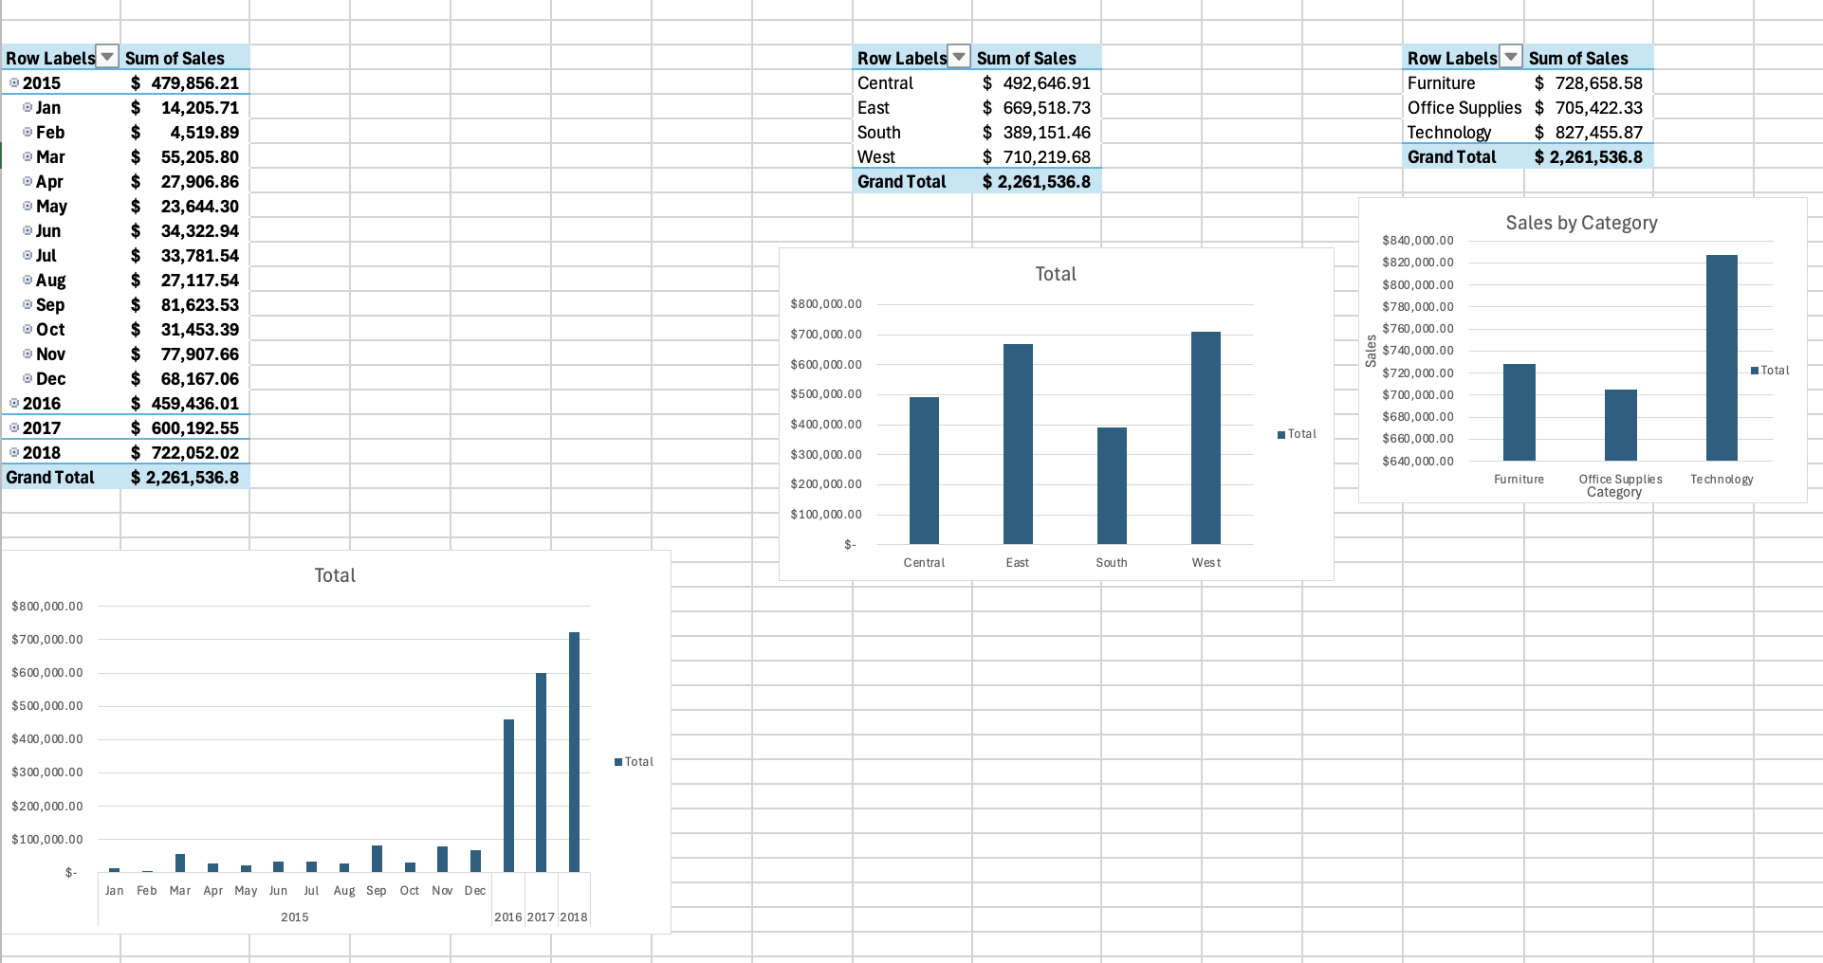

Slide 7


Slide 9


